Slide 1
RETAIL SALES DATASET ANALYSIS
Retail Sales

Slide 2
INTRODUCTION
Hello and welcome. In today’s presentation, I am excited to take you through this company’s retail sales dataset.
I am really excited to be doing this presentation as it has given me the opportunity to dive into, and gain insightful information about this store’s performance.

Slide 3
Hola, My Name Is Quansah Abaidoo Meshach, A Data Analyst And I Am Here Today To Take Us Through This Wonderful Presentation. Being A Data Analyst Hasn’t Being Easy Especially For Someone Without A Background In Computer Science Or Anything Relating To Data. However By The Grace Of God, Here We Are After 6 Solid Months. I Do Hope You Enjoy This Presentation And Oh Yh Let’s Have Fun Doing What We Love The Most. Let’s Goooooo
ABOUT ME

Slide 4
Process
I am excited to state that, I took the necessary process in ensuring that this project has passed through the necessary steps and procedure before finally arriving at the final result.
Two common data cleaning tasks are performed on the dataset. The first involves identifying NULL or missing values, while the second entails checking for any duplicated records. Power BI and Excel, both offers built-in features for both of these tasks.
Also I did use a little bit of dax formula in this project to group the various ages into “young adults, Early middle-aged, Late middle-aged and Old”. Kindly find the formula below;
Age_Group = IF(retail_sales_dataset[Age]<22,"Young Adults",IF(retail_sales_dataset[Age]>60,"Old",IF(retail_sales_dataset[Age]>21 && retail_sales_dataset[Age]<34,"Early Middle-aged","Late Middle-aged")))

Slide 5
OBJECTIVES
There are two main tasks identified when carrying out this project
Task 1: Efficiently clean, transform, and analyze the dataset
Task 2: Uncover valuable and unexpected hidden insights from the data, answering business questions and providing strategic recommendations

Slide 6
BUSINESS QUESTIONS / KPIs
How does customer age and gender influence their purchasing behavior?
Are there discernible patterns in sales across different time periods?
Which product categories hold the highest appeal among customers?
What are the relationships between age, spending, and product preferences?
Are there distinct purchasing behaviors based on the number of items bought per transaction?
What insights can be gleaned from the distribution of product prices within each category?

Slide 7
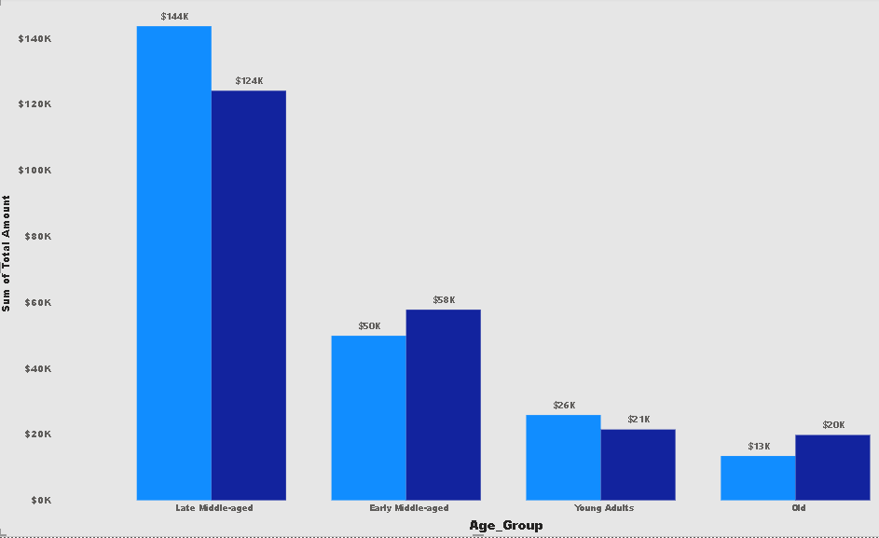
How AGE AND GENDER AFFECT INFLUENCE PURCHASE
Here, I used a dax formula to group the various ages into age groups. We can find that people between the ages of < 22 per the data set are classified as “young adults”, those above (>) 60, “Old”, those between 21 and 34 years old “Early middle-aged” and the rest, that is between 35 and 60, “late middle-aged”.
From here, we can deduce that people between the age bracket of 35 and 60 years are the highest contributing customers with the males in this bracket contributing a little more than females in same bracket.
This also shows how the elderly or old. That is people between the ages of above 60 years are our least contributing group with a significance difference between the late middle-aged group and old.

Slide 8
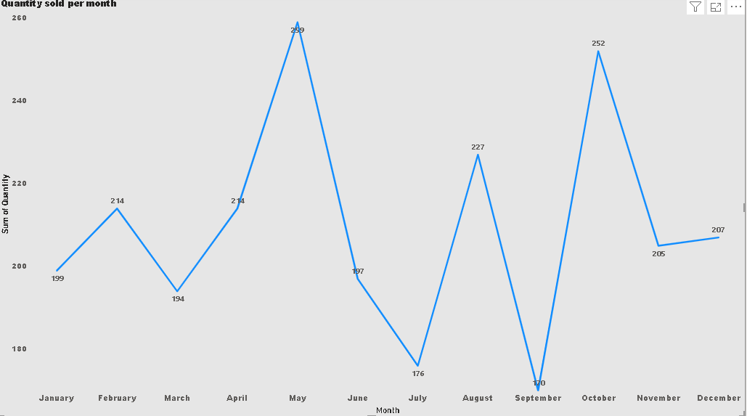
Sales across different time periods
Let’s take a look at this chat, we can clearly see the trend of sales across different months in the year. From the chat,we can see a fair increase in sales from the month of January to February with sales declining fairly in march.
However, we can see a significant increase in sales in May standing at 259 sales and October at 252 sales followed by August at 227 sales with sales being at it’s lowest during the months of September at 170 sales and July at 176.
We can also see like a stable small increase in sales from November to December.
This tells management that, demand is at its peak during the months of May, October and August and management must capitalize on these time periods.

Slide 9
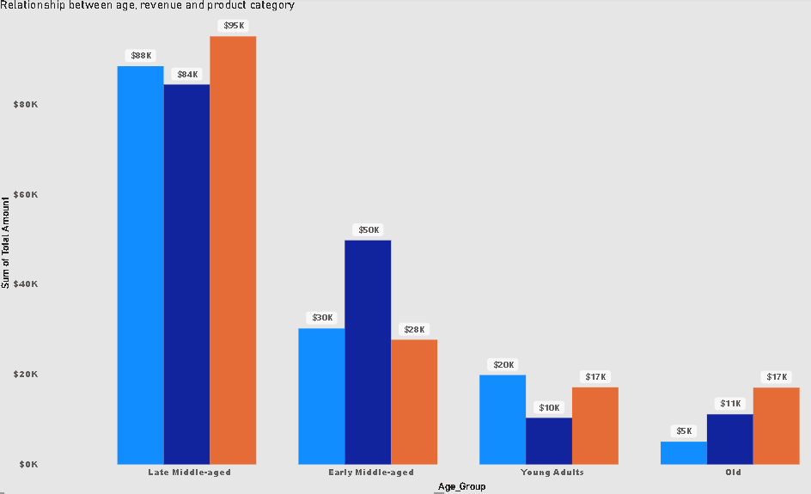
relationships between age, spending, and product preferences
From the above chat, we again have the age group of which I’ve talked about. But then, we also have the product category and there are three product categories.
1. Blue color- Beauty
2. Violet color- Clothing and
3. Orange color- Electronics
With that, we can begin to see the relationship where the chat shows that the late middle-aged being the highest contributing group tend to split their spending amongst all three product categories almost fairly. There really is no significant difference between their spending habit for all three product categories.
Same can perhaps be said for the “old” age group being the least revenue contributing group.
However, it’s a different case for the Early middle-aged and Young adults group. In the case of Young Adults, we can see they prefer to spend more on Electronics and beauty than on clothing by a fairly significant amount.
In the case of Early middle-aged, we see that they rather prefer to spend a significant amount on Clothing than the remaining two product preferences.

Slide 10
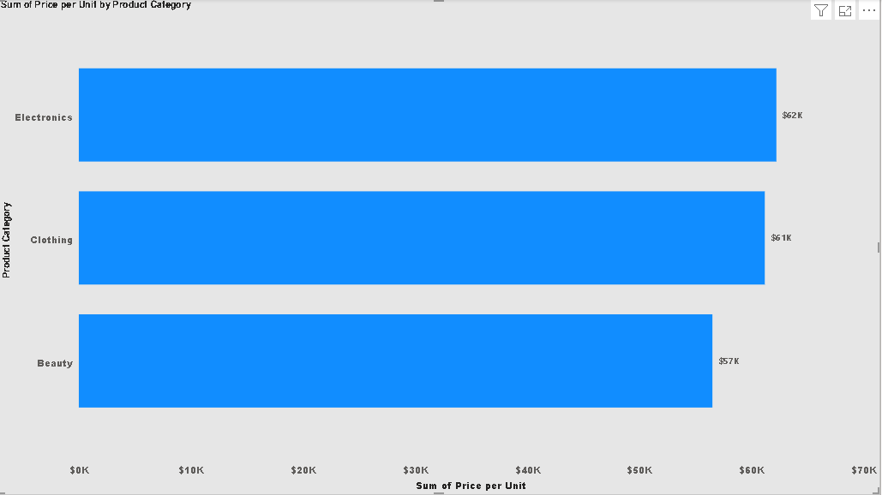
What insights can be gleaned from the distribution of product prices within each category?
The chart shows the total price within the three product categories from the store with the total price for electronics being $62,210, clothing being $61,175 and Beauty being $56,505.
However, we can also see from previous charts that even though the price for electronics is the highest, its still the most demanded product on average by customers across all age groups, with a total revenue of $156,905. However beauty being the lowest priced product is also the least demanded item on average across the various age groups with a total revenue of $143,515.
I would agree that that pricing for these products are about okay, except a slight increase in electronic products would be great looking at the number of sales its making.

Slide 11
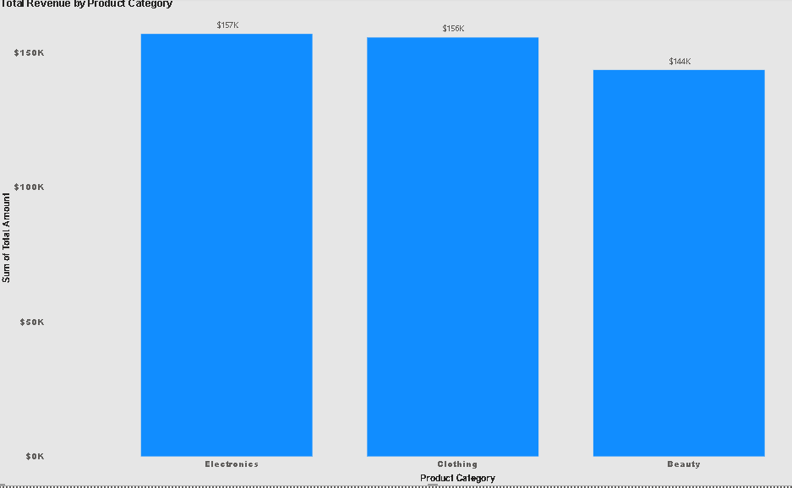
Which product categories hold the highest appeal among customers
From this chart, the highest appealing product among customers is electronics contributing an amount of $ 156,905 as total revenue, followed by Clothing contributing a total of $ 155580 and lastly Beauty contributing a total of $ 143,515 as total revenue.
However, there really isn’t any significant difference in sales or revenue if we are taking all age groups and total revenue into consideration.
As a result, it can be argued that they each hold the highest appeal only subjected to, which age group we want to target or our target age group.

Slide 12
RECOMMENDATIONS
Given that individuals aged 35 to 60 years are the highest contributing customer group, with males contributing slightly more than females, management should focus on tailoring marketing strategies and product offerings to this age bracket to maximize engagement and sales.
For the late middle-aged group (35-60 years):
Targeted Marketing: Develop targeted promotions and product lines that cater to their preferences and needs.
Customized Offers: Consider offering exclusive deals or loyalty programs for this demographic to increase retention and sales.
For the elderly group (above 60 years):
Engagement Strategies: Implement initiatives to better engage this age group, such as senior-friendly products or services and accessible promotions.
Feedback Collection: Gather feedback to understand their needs and preferences, aiming to tailor offerings that could increase their contribution.
Overall, focusing on the most significant contributors while also exploring ways to engage less active segments can help optimize overall customer engagement and sales performance.

Slide 13
RECOMMENDATIONS
Intensify marketing and promotional efforts during May, October, and August, when sales peak. Consider launching special offers, targeted campaigns, or events to maximize revenue during these high-demand months.
Develop strategies to boost sales in September and July, which have lower sales figures. This could include targeted promotions, discounts, or events to drive engagement and increase sales during these months.
Continue to track sales trends and adjust strategies dynamically based on real-time data to respond to changing demand patterns effectively.
Utilize the stable increase in sales from November to December to plan for end-of-year promotions and ensure inventory and resources are aligned with the anticipated demand.
Since Young Adults show a strong preference for Electronics and Beauty products, focus on enhancing and promoting these categories through targeted marketing campaigns, special deals, and new product launches to capitalize on their spending preferences.
Given the Early Middle-Aged group’s significant spending on Clothing, increase inventory and promotional efforts in this category to better serve this demographic. Consider exclusive clothing collections or targeted promotions to attract and retain this group.
For the Late Middle-Aged group, which spreads spending fairly evenly across all product categories, ensure a balanced and well-rounded product offering in Beauty, Clothing, and Electronics. For the Old age group, which contributes less to revenue, explore initiatives to increase their engagement and spending, such as tailored promotions or targeted product recommendations.
Continuously analyze spending patterns and adjust marketing and inventory strategies as needed to align with changing consumer preferences and maximize revenue across all age groups and product categories.

Slide 14
RECOMMENDATIONS
Consider implementing a slight price increase for Electronics. Given that Electronics is the highest-demand product with total revenue of $156,905 and the highest total price of $62,210, a modest price adjustment could enhance profitability while still capitalizing on its strong demand.
Since Clothing and Beauty have relatively lower total prices and varying demand levels, maintain their current pricing to balance competitiveness and profitability. Clothing is performing well, but Beauty, being the least demanded, should not see a price increase until there is a strategy to boost its demand.
Given that Beauty is the least demanded category despite its lower price, develop targeted marketing campaigns or special promotions to increase customer interest and drive sales. This could involve bundling Beauty products with higher-demand items or offering discounts and incentives.
Continuously track the sales performance and customer feedback for each product category. Adjust pricing strategies as needed based on changes in demand and market conditions to optimize revenue and customer satisfaction.
Action: Develop targeted marketing strategies tailored to different age groups. Focus on promoting Electronics to age groups that show high interest in this category, Clothing to those who prefer it, and Beauty to the specific demographics where it resonates the most.
Utilize customer data to design promotions and product bundles that cater to the preferences of each age group. For instance, run targeted campaigns or special offers for Electronics during periods when the target age group is most active.
Ensure a balanced inventory that reflects the interests of various age groups. Adjust stock levels based on the appeal of each category to avoid overstocking or understocking.
Continuously monitor sales performance and customer feedback for each product category. Be prepared to adjust marketing strategies and inventory allocations based on shifting trends and consumer preferences.

Slide 15
THANK YOU
Meshach Abaidoo Quansah

